Slide 1
Lecture 2: Paternalism and medical technologies
Med Etik TaMos - HT24
Barbro Fröding

Slide 2

Key points from previous lecture
Recap
Applied ethics aims to provide normative guidance – e.g. prescriptions and evaluations regrading practical moral problems
Normative claims need to be justified
  To justify is to provide convincing reasons for a claim
Reflective equilibrium – a coherentist theory
Ethical theories (top-down, bottom-up, mid-level theory)
Principlism – the four principles
Applying Principlism
  Make sure that you can: explain Principlism and the four principles and that you know how to apply that method.

Slide 3
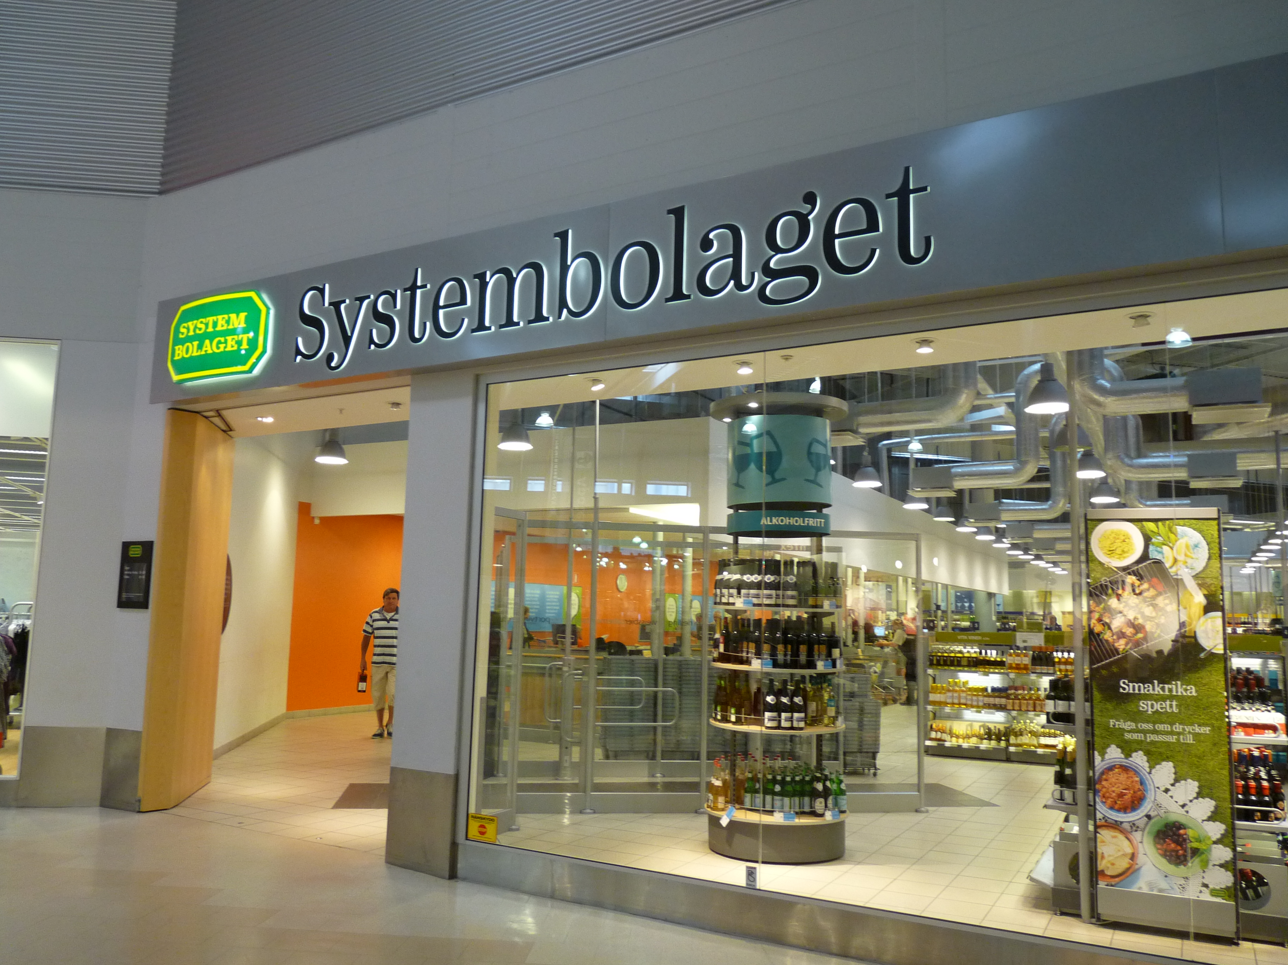
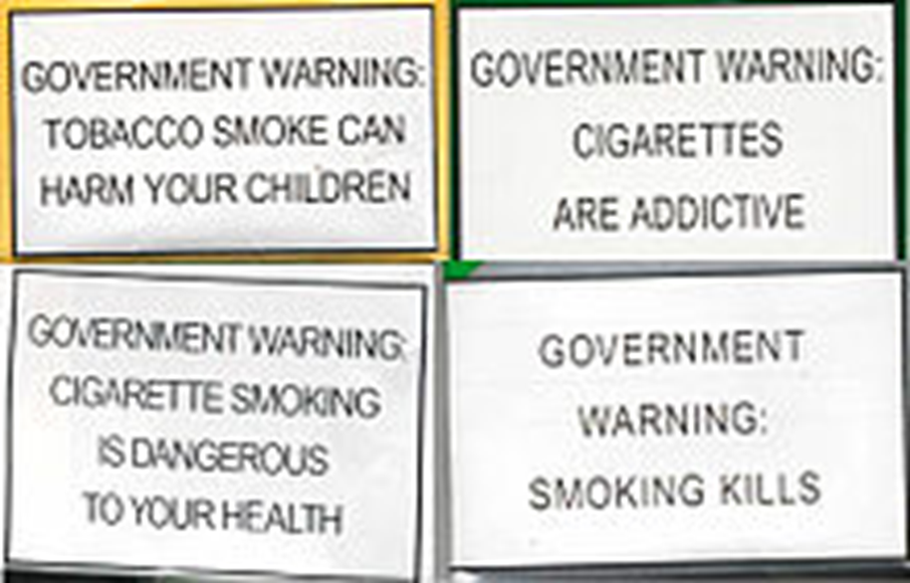

What unites these public health strategies is that they are often brought up as examples of paternalism
This Photo by Unknown Author is licensed under CC BY-SA

Slide 4
What is paternalism? Here is one definition:
“[T]he interference of a state or an individual with another person, against their will, and defended or motivated by a claim that the person interfered with will be better off or protected from harm.”
(Dworkin 2014)
NB – it’s the liberty or autonomy of the person that is interfered with.

Slide 5
Paternalistic interventions
HARD
If individuals are prevented from or manipulated into, performing an action or making a choice on the basis that this will be in their own best interests.
(Sometimes, the associated assumption is that they are not the best judge of their interests.)
(Begon 2016)
SOFT
Interventions that help individuals achieve goals they have set for themselves.
(Haybron and Alexandrova 2013)

Slide 6

Medical paternalism
Paternalism has been one of the traditional characteristics of medicine and public health. It’s been especially discussed in the context of the therapeutic relationship in medicine.
It implies that the physician makes decisions based on what they consider to be in the patient’s best interests, even for those patients who could make the decisions for themselves.
This Photo by Unknown Author is licensed under CC BY-SA-NC

Slide 7
Criteria for medical paternalism
For an act to qualify as medical paternalism 1 & 2 below are jointly sufficient
a physician or other healthcare professional undertakes actions designed to limit the exercise of the patient’s autonomy,
on the basis of clinical judgment and decision-making that are reliably beneficence based in order to protect the health-related interests of the patient from the consequences of the patient’s decisions and actions based on them.
Note that clinical judgement in (2) is shorthand for: expert clinical judgements which are both evidence-based and beneficence-based in their evaluation of the relevant evidence.
Notes:
We will return to the idea of reliably beneficience based and what that can mean later on

Slide 8
Recall the four principles in Principlism
Autonomy
Nonmaleficence
Beneficence
Justice
Philosophical problem: when, if ever, are paternalistic interventions permissible?

Slide 9
Some examples of negative patient outcomes
Recall that: “Paternalism implies that the physician makes decisions based on what they consider to be in the patient’s best interests, even for those patients who could make the decisions for themselves.”
So if we are to think of examples it might be tempting to point to some horrific practice like forced sterilization (some 60 000 cases in Sweden in the 1940s’ and 1950’s). Evidently those practices constituted a flagrant violation of human rights and ruined many peoples lives but strictly speaking that might not be medical paternalism, it does not meet the definition of clinical judgement nor of beneficence (expected positive outcome for that individual).
A standard example of medical paternalism is withholding information from patients about their conditions (undermines autonomy and decision-making) or when the physician frames the options to influence the decision or “disguised paternalism”, informed by the doctor’s own subconscious values.
But note that paternalism can be considered wrong even when the outcome for the patient could be conceived of as good (at least from a somatic perspective).
Notes:
(can also be disguised paternalism, informed by the doctor’s own subconscious values), as in examples of assisted suicide where some doctors would say that the patient isn’t decision competent and therefore their wish to die shouldn’t be respected)

Slide 10
Today, we will zoom in and look at debates concerning paternalism and personalised medicine (especially personalised risk scores).

Slide 11
What is personalised medicine?
Personalised medicine can be understood as a practice where:
“Personalized medicine is an emerging practice of medicine that uses an individual's genetic profile to guide decisions made in regard to the prevention, diagnosis, and treatment of disease. Knowledge of a patient's genetic profile can help doctors select the proper medication or therapy and administer it using the proper dose or regimen. ” NIH National human genome research institute
Vocabulary:
“Precision medicine is a way health care providers can offer and plan specific care for their patients, based on the particular genes, proteins, and other substances in a person’s body. This approach is also sometimes called personalized medicine or personalized care.” American Cancer Society

Slide 12
What is the purpose of personalised medicine?
”Personalized medicine, often referred to as precision medicine, is an evolving field in which physicians use molecular diagnostic tests to determine which medical treatments and strategies will work best for their patients.
By combining the data from those tests with an individual’s medical history, circumstances, and values, health care providers and patients can develop targeted treatment and prevention plans.”
http://www.personalizedmedicinecoalition.org/Userfiles/PMC-Corporate/file/PMC_Moving_Beyond_Population_Averages_A_Patient-Centered_Research_Agenda_Advancing_Personalized_Medicine1.pdf

Slide 13
Potential benefits of personalised medicine
better medication effectiveness, since treatments are tailored to patient characteristics, e.g., genetic profile;
reduction of adverse event risks through avoidance of therapies showing no clear positive effect on the disease, while at the same time exhibiting (partially unavoidable) negative side effects;
lower healthcare costs as a consequence of optimized and effective use of therapies;
early disease diagnosis and prevention by using molecular and non-molecular biomarkers;
improved disease management with the help of wearable sensors and mobile health applications;
smarter design of clinical trials due to selection of likely responders at baseline
(see Frölich et al 2018)
Notes:
Start by saying this:
Medical decisions are based on individual patient characteristics (e.g. biomarkers) rather than the averages over a whole population. That stands to revolutionise the management of many illnesses because:
BAYS-line) An initial measurement of a condition that is taken at an early time point and used for comparison over time to look for changes. For example, the size of a tumor will be measured before treatment (baseline) and then afterwards to see if the treatment had an effect.

Slide 14

What are the relevant medical technologies?
“Within the next decade we will see an evolution in medicine as we understand more about the underlying drivers of a patient’s condition and their individual response. …This evolution to personalisation in medicine is not new, but is being driven by scientific advances and the development of new technologies, particularly the huge leaps in computing power that have driven the development of artificial intelligence and data analytics. Innovations such as 3D printing and circulating tumour DNA analysis are also providing ways of personalising care as never before.”
Prof. Dame Sue Hill (Chief Scientific Officer for England)
(https://www.phgfoundation.org/documents/phgf-personalised-medicine-technology-landscape-report-50918.pdf

Slide 15
Personalised risk scores
A personalised risk score (or personal risk information) estimates the probability of future health outcomes for individual patients.
Personalised risk scores are regarded promising, because
  they could help clinicians and other medical practitioners to better predict whether individuals will develop disease
  more effective prevention and treatment options
For more information and concrete examples, see e.g.
Han PKJ, Hootsmans N, Neilson M, et al The value of personalised risk information: a qualitative study of the perceptions of patients with prostate cancer BMJ Open 2013;3:e003226. doi: 10.1136/bmjopen-2013-003226
Edwards AGK, Naik G, Ahmed H, Elwyn GJ, Pickles T, Hood K, Playle R. Personalised risk communication for informed decision making about taking screening tests. Cochrane Database of Systematic Reviews 2013, Issue 2. Art. No.: CD001865. DOI: 10.1002/14651858.CD001865.pub3. Accessed 03 December 2020.
Notes:
Start by saying this:
Medical decisions are based on individual patient characteristics (e.g. biomarkers) rather than the averages over a whole population. That stands to revolutionise the management of many illnesses because:

Slide 16
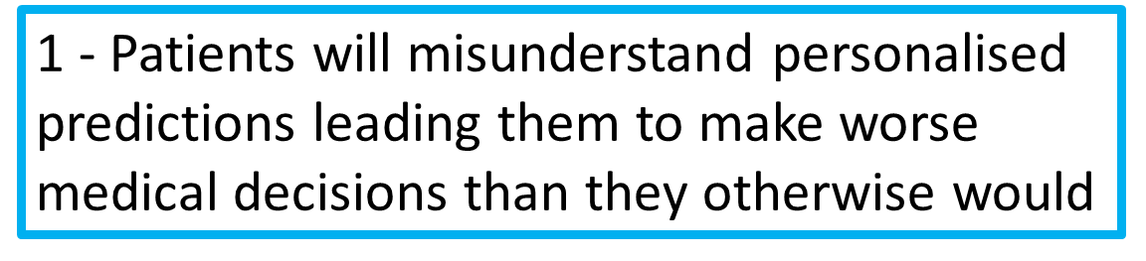
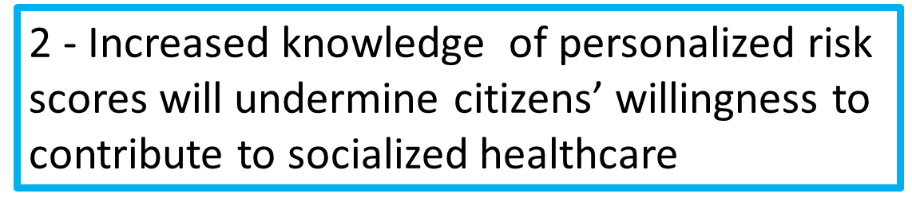
Sceptical approach
According to Stephen John (and others) there are two reasons to be sceptical of claims that imply that personalised risk score technologies will pave the way for effective prevention:
John, S. (forthcoming). Artificial Ignorance, Epistemic Paternalism and Epistemic Obligation(Ch.1). In Epistemic Paternalism Reconsidered, ed. Axtell and Bernall

Slide 17
“Both concerns, if valid, imply reasons to control the flow of information from personalised medical tests: the first implies that results should be available only when they are interpreted and contextualised by intermediary experts, such as trained genetic counsellors; the second implies reasons against allowing test results to be available at all.” (John forthcoming, p.1)
?
Should we control the flow of information?
Or: how strongly should we control the flow of information?

Slide 18
Recall that paternalism is
“[T]he interference of a state or an individual with another person, against their will, and defended or motivated by a claim that the person interfered with will be better off or protected from harm.”
(Dworkin 2014).

Slide 19
So we are back to our original question
When, if ever, are paternalistic interventions justified?
Or: When are the controls on the flow of information on personal health risks permissible?

Slide 20
Break
15 min

Slide 21
Are controls on the flow of information on personal health risks permissible?
We will consider three responses:
(1) Not permissible (Extreme autonomy!)
(2) Permissible (Extreme beneficence!)
(3) Permissible. New framework: obligations.

Slide 22
Response 1.
Controls on the flow of information are not permissible at all, because such controls place limits on freedom of inquiry, and placing limits of freedom of inquiry is not in the patients’ (epistemic) interests.
Rejects both the worries expressed by John – ‘bad’ reasons (even if they turned out to be correct that would not mean that they are overriding reasons)

Slide 23
Response 1: not permissible to control flows of information
Motivated by anti-paternalism
According to the strongest form of anti-paternalism – ‘hard anti-paternalism’ – one must never interfere with any self-regarding choice or action performed by an adult.
But how compelling is response 1?
  Can’t we imagine situations when we would be better off with filtered information? Or at least some form of controls of information?

Slide 24
Response 2.
Controls on the flow of information are permissible, because increased knowledge of personalised risk scores will undermine citizens’ willingness to contribute to socialised healthcare.

Slide 25
Discussion from John (forthcoming) spelled out
Principles of justice demand that there a form of socialised healthcare available, where healthcare provision is, at least partially, funded through general taxation.
Us who contribute to socialised healthcare systems do so because such a contribution is in our own interest. There is a good chance that we will need to access such a system in the future!
Point/premise (2) rests on the assumption that we all are on a roughly equal risk of needing healthcare in the future. But some citizens undersanding their personal risk scores really, really well undermines this assumption. What seemed like a prudent investement becomes a burdensom subsidy for them!
Undermines citizens willingness to contribute to socialised healthcare, which is a serious worry.

Slide 26
“Allowing access to personalised medical results will undermine the solidaristic attitudes necessary for sustaining [socialised healthcare] institutions which are demanded by justice.”
(John (forthcoming), p. 9)
If this is true then some paternalistic interventions on the flow of information are justified

Slide 27

A counter argument against response 2
We might question that personalised medicine must undermine solidarity. (Praisanck and Buyx 2017)
“[…] a solidarity-based perspective enables us to see that personalised medicine can be harnessed and understood in a different way to the more individualistic interpretation that emerges when it is mainly considered in the context of genetic and other biomarkers (Hamburg and Collins 2010). And solidarity also gives us the tools to start harnessing this potential.” (2017, p.138)
“. […] A universal healthcare system organised in a solidaristic spirit would be the best safeguard against the scenario that personalisation would be used to justify undue exclusion, or distributed according to people’s ability to pay, rather than their need. ” (p. 138)
So for Prainsack and Buyx, access to personalised risk scores will not automatically jeopardise socialised healthcare (or make people less willing to contribute), insofar as we are striving for a more solidaristic system overall.
But perhaps maintaining “solidaristic attitudes” does call for some restrictions on the flow of information?
→ then Prainsack and Buyx’s argument is not all that convincing if mobilised to support unrestricted access to personalised risk scores.

Slide 28
Are controls on the flow of information on personal health risks permissible?
We will consider three responses:
(1) Not permissible (Extreme autonomy!)
(2) Permissible (Extreme beneficence/solidarity!)
(3) Permissible. New framework: obligations.

Slide 29
Obligations
John (forthcoming).
“(…) debates over epistemic paternalism lead us to problems about how to commensurate freedom and the good. I will now suggest that an advantage of the alternative, “obligation-first” approach is that it avoids this problem.”

Slide 30
Obligations towards ourselves
Self-directed epistemic obligation
  “An obligation to acquire or maintain some epistemic state, derived from a more fundamental ethical obligation.”
  Example: an obligation to become better informed.
But! We can also have an obligation to not be informed.
  “For example, in virtue of my more general obligations to respect my friend’s privacy, I have an obligation not to read his secret diary which he has left open on the table. I can have obligations to remain ignorant (Manson, 2012).”
[All the direct quotes are from (John, forthcoming).]

Slide 31
Obligations towards others
Epistemic enablement obligations
  “obligations to enable others to meet their epistemic obligations.”
Just as we can have obligations of ignorance, others may have an obligation to enable us to maintain our ignorance.
  “For example, a third party, who knows that I am insatiably (but improperly) curious about my friend’s private life, finds my friend’s diary open on the table. She has, I suggest, an obligation to hide away the diary as a way of enabling me to ensure that I meet my obligation of ignorance.”
[All the direct quotes are from (John, forthcoming).]

Slide 32
Obligations
Citizens have obligations – grounded in their broader duties to support just institutions – not to gain more personalised information.
  “our obligation to support just institutions can place limits on our pursuit of our prudential interests “
The state has a correlative duty to enable citizens to fulfill of these obligations.
  “the second obligation follows as a result of States’ duties to cultivate citizens’ dispositions to advance justice (Macedo, 1992).”
This is a relational account more related to ethics of care than say rights and duties. There is a focus on justice, equity and fairness and the commitment to these values necessitates obligations that will restrict some actions that the alternative individualistic/ rights philosophy emphasises

Slide 33
Stephen John’s conclusion
“[r]ather than conceptualise information control policies in terms of a clash between rights and consequences, we can, instead, think about them as embedded in wider patterns of socioepistemic obligation. Of course, weighing and assessing different obligations is not an easy task, but it is easier than balancing freedom against the good.”
Given this justice orientated framework there should be controls on the flow of information
But, note that while he says that epistemic paternalism is not the most useful tool, rather we should think in terms of “interlocking sets of epistemic obligations” that is not to say that all controls on information are just –
“For example, there may be ethical reasons why the State should control the flow of personalised information, maintaining a just healthcare system, but, also, good ethical reasons to worry that these powers might be abused to maintain unjustifiable forms of ignorance. As such, there may well be pressing ethical, political and practical reasons to resist controls on the flow of information.”

Slide 34
Discussion 15 min – choose 2 examples
Is it an act if medical paternalism? Does it meet the two criteria? A) designed to limit autonomy and B) reliably beneficence based
Is it justifiable? Identify and specify the value tension. Give ethical reasons for and against
Ex 1 – A blood transfusion to save the life of an adult Jehovah's witness without their informed consent
Ex 2 – Compulsory bicycle helmets for adults
Ex 3 – Increase VAT by 300% on un-healthy produce e.g. candy, soda, crisps..
Ex 4 – The doctor deems the patient too frail to handle the cancer diagnosis and decides not to tell the patient. The patient is in her 90s and expected to die within 6 months due to an unrelated disease. The patient is cognitively clear and has full decision making capacity.
Ex 5 – The doctor is convinced that the new surgical technique she has developed is superior to the available alternative techniques and methods. It has been tested rigorously and there is evidence to support it’s reliability. It’s a good technique but not as outstanding as the doctor believes. She tells the patient about all the alternatives but emphasises the benefits of her own. She is not neutral and it is possible that she manipulates the patient a little bit but she is convinced that her technique would be the best choice for this patient. The patient goes with the doctors recommendation and has the surgery. The patient recovers quickly and is very happy.
Notes:
So I don’t want to hear – it’s a tension between autonomy and beneficence – I know that, that’s sort of the definition of paternalism
I want to to elaborate – why and in what way does it undermine the pateints autonomy. How is this act defended as beneficence. Articulate – recall the quote from lecture one – on specificationthe doctor
spelling out where, when, why, how, by what means, to whom, or by whom
s it weak/soft (interfering with the means) or strong/hard (interfering with the ends) paternalism?

Slide 35

Summary
We have been looking at paternalism, i.e. when is it justified for a state to interfere with individual’s life (freedom/autonomy, and wellbeing)
We studied paternalism in placing controls on the flow of information regarding personalised risk scores
And we looked at an obligations–orientated framework (which places more importance on justice over autonomy/freedom)
The questions at the essay writing session will not involve any detailed questions on Stephen John’s arguments.

Slide 36
Further readings and references from the lecture
Begon, Jessica. "Paternalism." Analysis 76, no. 3 (2016): 355-373.
Dworkin, Gerald, "Paternalism", The Stanford Encyclopedia of Philosophy (Fall 2020 Edition), Edward N. Zalta (ed.), URL = <https://plato.stanford.edu/archives/fall2020/entries/paternalism/>.
Fröhlich, Holger, Rudi Balling, Niko Beerenwinkel, Oliver Kohlbacher, Santosh Kumar, Thomas Lengauer, Marloes H. Maathuis et al. "From hype to reality: data science enabling personalized medicine." BMC medicine 16, no. 1 (2018): 150.
Haybron, D.M. and A. Alexandrova. 2013. Paternalism in economics. In Paternalism:
Theory and Practice, ed. C. Coons and M. Weber, 157–77 Cambridge: Cambridge
University Press.
Mesko, Bertalan. The role of artificial intelligence in precision medicine. Expert Review of
Precision Medicine and Drug Development 5(2) (2017), 239-241
Pirmohamed, M. (2001). Pharmacogenetics and pharmacogenomics. British Journal of Clinical Pharmacology, 52(4), 345–347. https://doi.org/10.1046/j.0306-5251.2001.01498.x
Salari, K. (2009). The Dawning Era of Personalized Medicine Exposes a Gap in Medical Education. PLOS Medicine, 6(8), e1000138. Retrieved from https://doi.org/10.1371/journal.pmed.1000138

